Slide 1
APPLIED AI DESIGN WORKSHOP
DAY 5 · Google Colab
DAY 5 · WORKED EXAMPLE
Guided LLM Prompt Chain
in Google Colab
Recreate a full machine-learning notebook using a controlled LLM prompt sequence and a cloud notebook environment.
Input file
LLM role
Colab role
Human role
classification_workshop.csv
220 process runs
Target: defect
Draft notebook cells
Explain code
Add human checks
Run code in browser
Upload dataset
Share notebook
Audit assumptions
Validate metrics
Approve claims
Evidence → Prompt → Google Colab notebook → Results → Model card → Human validation
Guided LLM Prompt • Google Colab workflow
1

Slide 2
APPLIED AI DESIGN WORKSHOP
DAY 5 · Google Colab
Worked example overview
Colab-ready
What participants produce by the end of the Colab-guided prompt-chain demonstration
Input file
LLM task
Colab task
Success criterion
classification_workshop.csv
Inputs:
• temperature_c
• pressure_kpa
• speed_mm_s
• vibration_mm_s
Target: defect
Generate notebook-ready markdown and code.
Use exact column names.
Add a human verification check after each notebook section.
Create notebook.
Upload CSV.
Run cells.
Restart runtime and run all.
Share or download final notebook.
The notebook should not just run. Faculty must be able to defend every modeling choice, metric, and conclusion.
Final product: runnable Colab notebook + prompt-response log + baseline/model comparison + model card
Guided LLM Prompt • Google Colab workflow
2

Slide 3
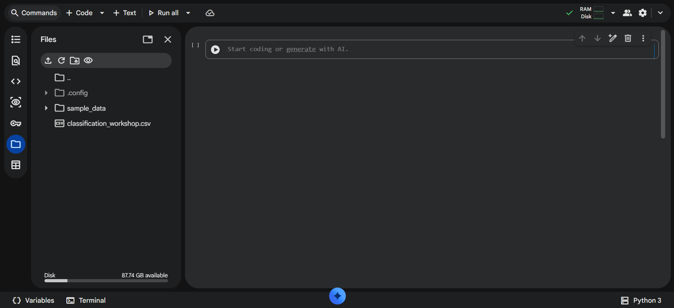
APPLIED AI DESIGN WORKSHOP
DAY 5 · Google Colab
Google Colab setup
Setup
Start with a clean browser-based notebook so every participant can run the same workflow
Step 1 — Open Colab
Step 2 — Upload dataset
Step 3 — Confirm runtime
Go to colab.research.google.com and create a new notebook. Rename it:
Day5_LLM_Generated_ML_Pipeline.ipynb
Use the file pane or run a file-upload cell. Upload classification_workshop.csv into the Colab runtime.
Runtime → Restart session, then run cells from the top. Keep random_state=42 for consistent class results.
https://colab.research.google.com/
Guided LLM Prompt • Google Colab workflow
3

Slide 4
APPLIED AI DESIGN WORKSHOP
DAY 5 · Google Colab
Prompt-chain map in Colab
7 prompts
Seven short prompts replace one vague request
0
Guardrails
1
Frame
2
Audit
3
Leakage
4
Features
5
Pipeline
6
Evaluate
7
Model card
For each prompt
Colab notebook habit
Human checkpoint
Collect the exact prompt, the LLM-generated notebook section, and a human audit note: accept, revise, or reject.
Paste generated code into one small cell at a time. Run the cell before continuing to the next prompt.
Do not continue if the LLM invents columns, ignores the baseline, fits preprocessing too early, or overclaims causality.
Guided LLM Prompt • Google Colab workflow
4

Slide 5
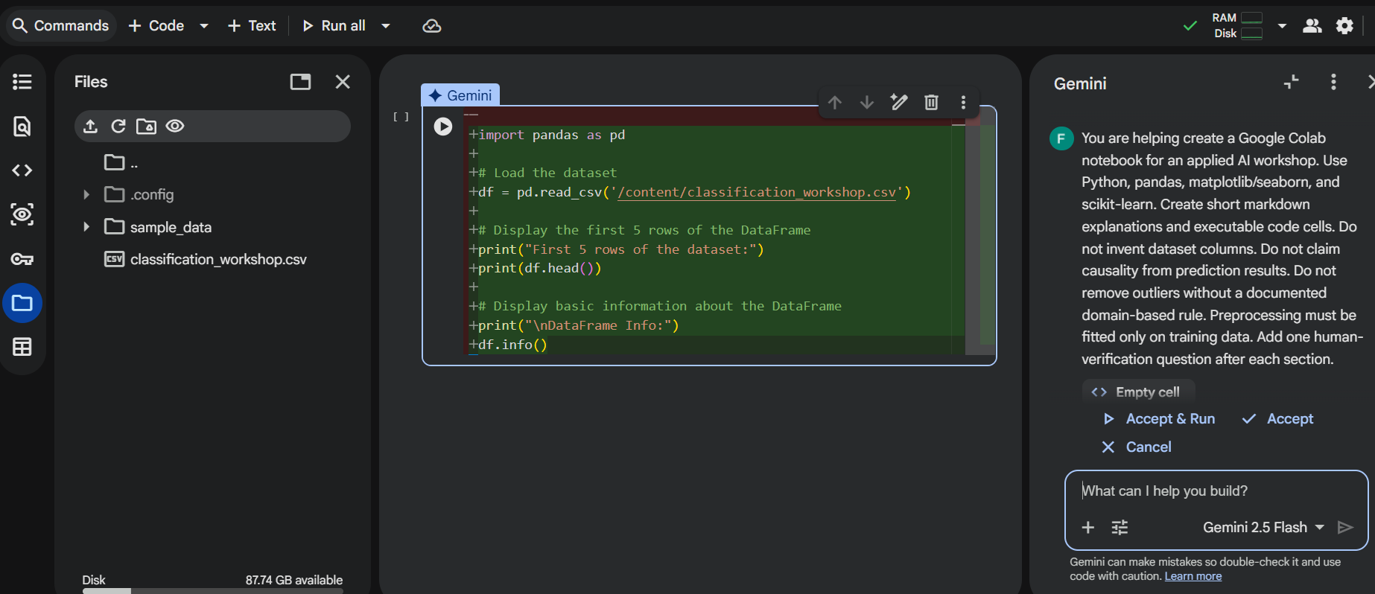
APPLIED AI DESIGN WORKSHOP
DAY 5 · Google Colab
You are helping create a Google Colab notebook for an applied AI workshop.
Use Python, pandas, matplotlib/seaborn, and scikit-learn.
Create short markdown explanations and executable code cells.
Do not invent dataset columns.
Do not claim causality from prediction results.
Do not remove outliers without a documented domain-based rule.
Preprocessing must be fitted only on training data.
Add one human-verification question after each section.
Prompt 0 — Establish role and guardrails
Copy-paste
Use this before generating any notebook code
Worked response
Reject response
The LLM should acknowledge constraints and ask for dataset name and column list before writing code.
Do not accept a response that immediately invents variables, deploys the model, or writes code using unknown columns.
Colab checkpoint
Open a new text cell titled “Prompt log.” Paste Prompt 0 and the LLM response. This creates an auditable record of how the notebook was generated.
Guided LLM Prompt • Google Colab workflow
5

Slide 6
APPLIED AI DESIGN WORKSHOP
DAY 5 · Google Colab
Prompt 1 — Problem framing
Frame
Generate the first Colab markdown and setup code cells
Dataset: classification_workshop.csv
Columns: temperature_c, pressure_kpa,
speed_mm_s, vibration_mm_s, defect
Create notebook-ready markdown and code that identify:
unit of observation, inputs, target,
model task, baseline, and metric.
Element Worked example
Unit One process run
Inputs temperature, pressure, speed, vibrat…
Target defect: 0 = acceptable; 1 = defective
Task Binary classification
Baseline Predict majority class
Metric Recall/F1, not accuracy alone
Colab output
Create one markdown cell for the framing table and one code cell defining features, target, and positive class.
Human check
Are all inputs available before final inspection? Is “defect” defined consistently?
Guided LLM Prompt • Google Colab workflow
6

Slide 7
APPLIED AI DESIGN WORKSHOP
DAY 5 · Google Colab
Prompt 2 — Data audit and visualization
Audit
Use Colab to verify the dataset before modeling
Generate notebook cells to load the CSV and report:
- df.head(), df.shape, df.dtypes
- missing values and duplicates
- target class balance
- summary statistics
- count plot of defect
- scatter or box plots for variables
Worked audit
Evidence
Rows: 220
Accept: 176
Defect: 44
Missing: 0
Imbalance is present. A majority baseline can reach 80% accuracy while finding no defects.
df.shape
df.dtypes
df.isna().sum()
df["defect"].value_counts(normalize=True)
Human check
Did the LLM use actual columns? Do the plots show class balance and feature ranges rather than decorative figures?
Guided LLM Prompt • Google Colab workflow
7

Slide 8
APPLIED AI DESIGN WORKSHOP
DAY 5 · Google Colab
Prompt 3 — Leakage and availability review
Trust check
Provide the prediction time so the LLM can reason about leakage
Prediction time: before final quality inspection.
Inputs: temperature_c, pressure_kpa,
speed_mm_s, vibration_mm_s.
Target: defect.
Create a table: variable, role, available at prediction time?, leakage risk?, decision.
Variable Risk Decision
temperature_c Low Keep
pressure_kpa Low Keep
speed_mm_s Low Keep
vibration_mm_s Low Keep
defect Target Do not use as input
Colab note
Human check
Place the leakage table in a markdown cell before the modeling code. It documents what the model is allowed to know.
The LLM cannot know timing unless you provide it. Add workflow context before accepting keep/remove decisions.
Guided LLM Prompt • Google Colab workflow
8

Slide 9
APPLIED AI DESIGN WORKSHOP
DAY 5 · Google Colab
Prompt 4 — Feature engineering with discipline checks
Features
Use AI to suggest features, not to approve them automatically
Suggest candidate features using temperature,
pressure, speed, and vibration.
Separate into:
1. domain-informed
2. mathematically convenient
3. risky or possibly leaky
Provide code only for justified features.
Do not claim causality.
Feature Status Rationale
temperature_devia… Clarify Need nominal temperatu…
pressure_deviation Clarify Need target pressure
vibration_speed_r… Test May reflect instabilit…
future inspection… Reject Outcome-derived leakage
Worked decision
Teaching point
For the simplified Colab demo, keep raw features only. Save engineered features as next-step hypotheses.
AI-generated features are hypotheses. They are not evidence until tested and validated.
Guided LLM Prompt • Google Colab workflow
9

Slide 10
APPLIED AI DESIGN WORKSHOP
DAY 5 · Google Colab
Prompt 5 — Generate the reproducible Colab pipeline
Code cells
The key technical cell: split, baseline, pipeline, predict, evaluate
X = df[features]
y = df["defect"]
X_train, X_test, y_train, y_test = train_test_split(
X, y, test_size=0.25, stratify=y, random_state=42
)
baseline = np.full(len(y_test), y_train.mode()[0])
model = Pipeline([
("scale", StandardScaler()),
("classifier", LogisticRegression(max_iter=1000))
])
model.fit(X_train, y_train)
pred = model.predict(X_test)
Audit checks
Revise if
✓ Split before fitting
✓ Baseline same test set
✓ Scaler inside pipeline
✓ Fixed random_state
✗ scaler fit before split
✗ training-set evaluation
✗ no baseline
✗ invented features
Colab practice
Run the code cell, then immediately add a markdown cell titled “Human audit.” Record whether the pipeline passed the checks.
Categorical reminder
For categorical features, use ColumnTransformer and OneHotEncoder. This simplified file has numeric inputs only.
Guided LLM Prompt • Google Colab workflow
10

Slide 11
APPLIED AI DESIGN WORKSHOP
DAY 5 · Google Colab
Worked model results
Results
The output the Colab notebook should reproduce
Baseline accuracy
Baseline recall
Model accuracy
Model precision
Model recall
0.800
predicts every run acceptable
0.000
finds no defects
0.855
slightly higher overall
1.000
no false alarms
0.273
misses most defects
Predicted … Predicted …
Actual acceptable 44 0
Actual defect 8 3
Model interpretation
The model is conservative: when it flags a defect it is correct, but it detects only 3 of 11 actual defects. It should not replace inspection.
Guided LLM Prompt • Google Colab workflow
11

Slide 12
APPLIED AI DESIGN WORKSHOP
DAY 5 · Google Colab
Prompt 6 — Evaluation and error analysis
Metrics
Separate direct evidence from unsupported claims
Interpret these results for a process engineer.
Separate:
- direct evidence
- reasonable interpretation
- unsupported conclusions
- most costly error
- recommended next analysis
Missed defects are more costly than false alarms.
Category Worked response
Direct eviden… Accuracy rose from 0.800 to 0.855; re…
Interpretation Model is cautious and misses many def…
Unsupported Process variables cause defects
Costly error False negatives: 8 missed defects
Next analysis Threshold sweep, class weighting, cro…
Human check
If the LLM says the model is “ready for deployment,” revise. Evidence supports limited screening value only.
Guided LLM Prompt • Google Colab workflow
12

Slide 13
APPLIED AI DESIGN WORKSHOP
DAY 5 · Google Colab
Prompt 7 — Completed model card
Model card
Final documentation section for the Colab notebook
Create an initial model card with:
- intended use
- out-of-scope use
- dataset and target
- baseline result
- model result
- primary error pattern
- supported conclusion
- unsupported conclusion
- limitations
- recommended next analysis
Field Worked entry
Intended use Teaching example; inspection prioritiza…
Out-of-scope Automatic part approval or production d…
Result Acc 0.855, precision 1.000, recall 0.273
Error pattern Missed 8 of 11 actual defects
Do not claim Variables cause defects
Next step Tune threshold and collect more defect …
Colab deliverable
One evidence-grounded paragraph plus the structured model-card table in markdown.
Guided LLM Prompt • Google Colab workflow
13

Slide 14
APPLIED AI DESIGN WORKSHOP
DAY 5 · Google Colab
Closing synthesis
Takeaways
AI drafts the artifact; faculty validate the workflow
Data evidence
LLM drafts
Metrics evaluate
Human validates
Colab runs the notebook and exposes the actual tables, plots, and metrics.
The LLM creates a first-pass notebook scaffold and explanation.
Baseline, confusion matrix, and recall reveal whether the model is useful.
Faculty approve assumptions, code, metrics, and claims.
Final message: Google Colab makes the workflow easy to run, but trustworthy AI use still depends on human-validated evidence and clear boundaries.
Do not ask: “Can AI build the notebook?” Ask: “Can we inspect, run, and defend every cell the AI helped create?”
Guided LLM Prompt • Google Colab workflow
18

